Slide 1
Low Rank Approximations: Part II

Slide 2
Lossy Compression
Exam 1
1a: 9/10
1b: 5/5
2a: 3/4
2b: 5/5
Exam 2
1: 18/20
2: 15/18
...
Exam 1: 92.5%
Exam 2: 88.7%
...
BIOE 210: B+
BIOE 360: A-
PHYS 220: B
...
GPA: 3.45

Slide 3
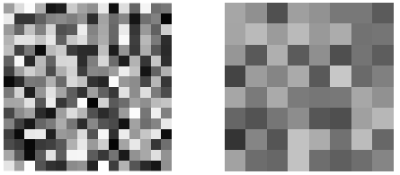
Simple lossy compression by Nearest Neighbors

Slide 4
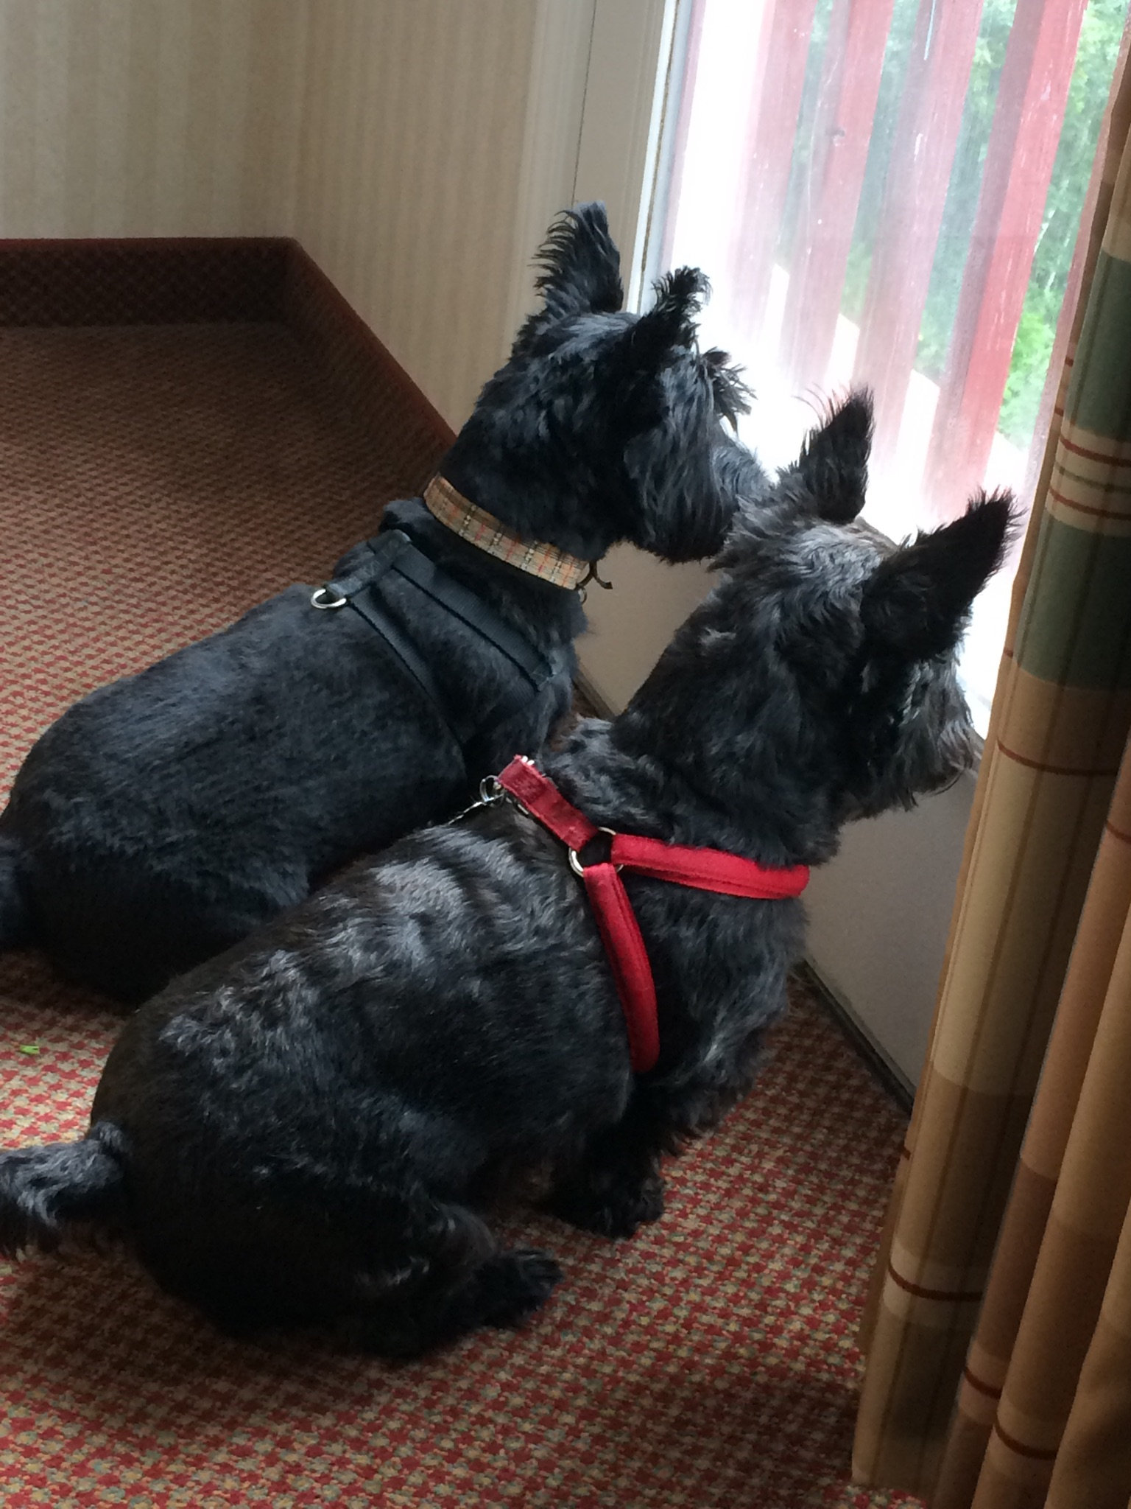
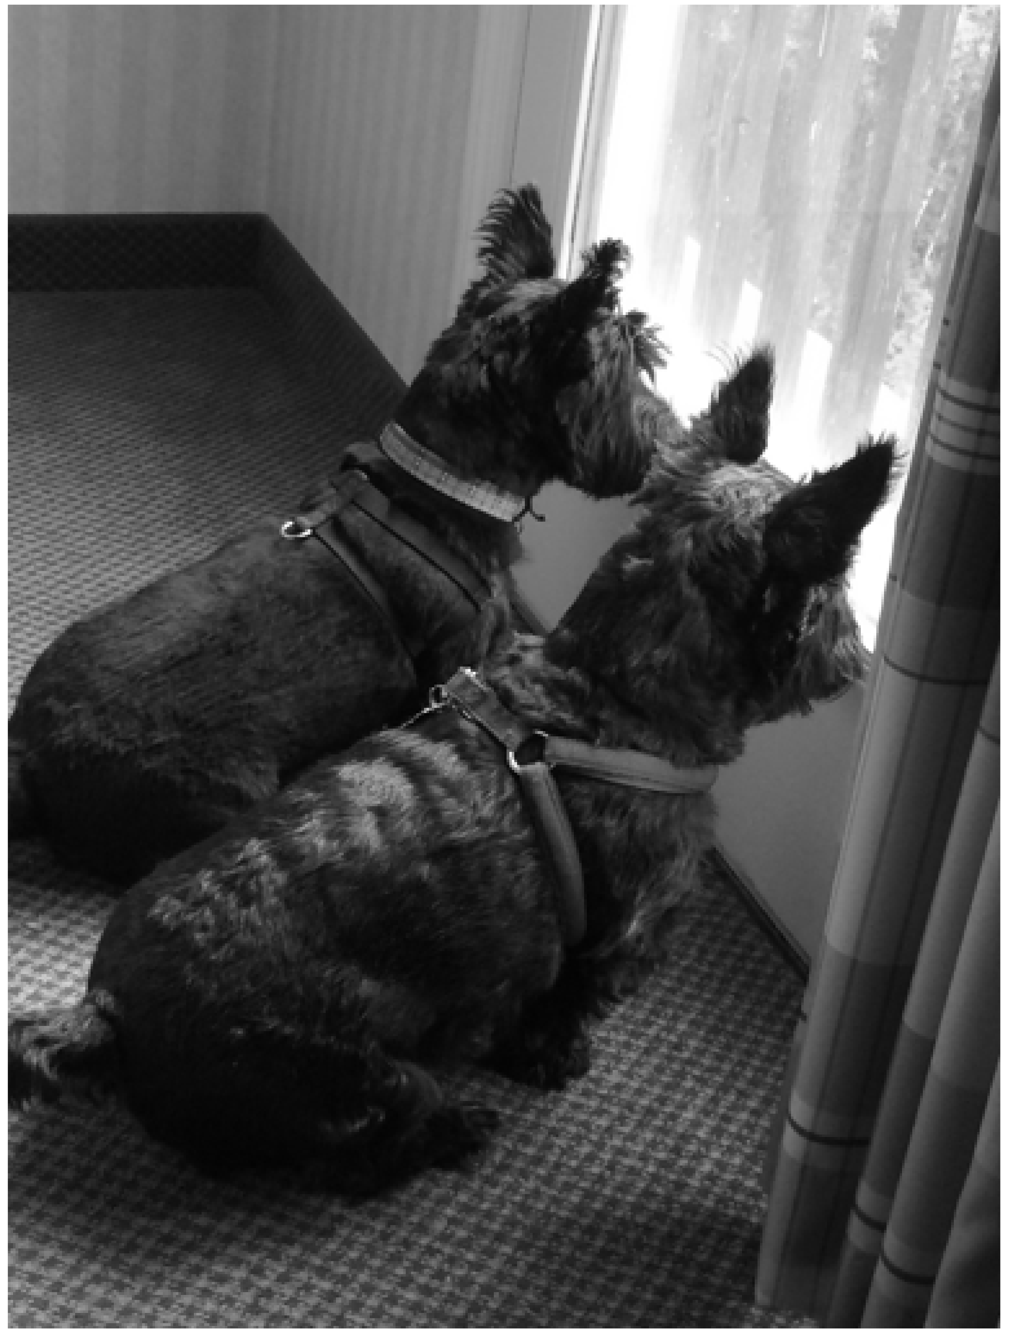

Slide 6
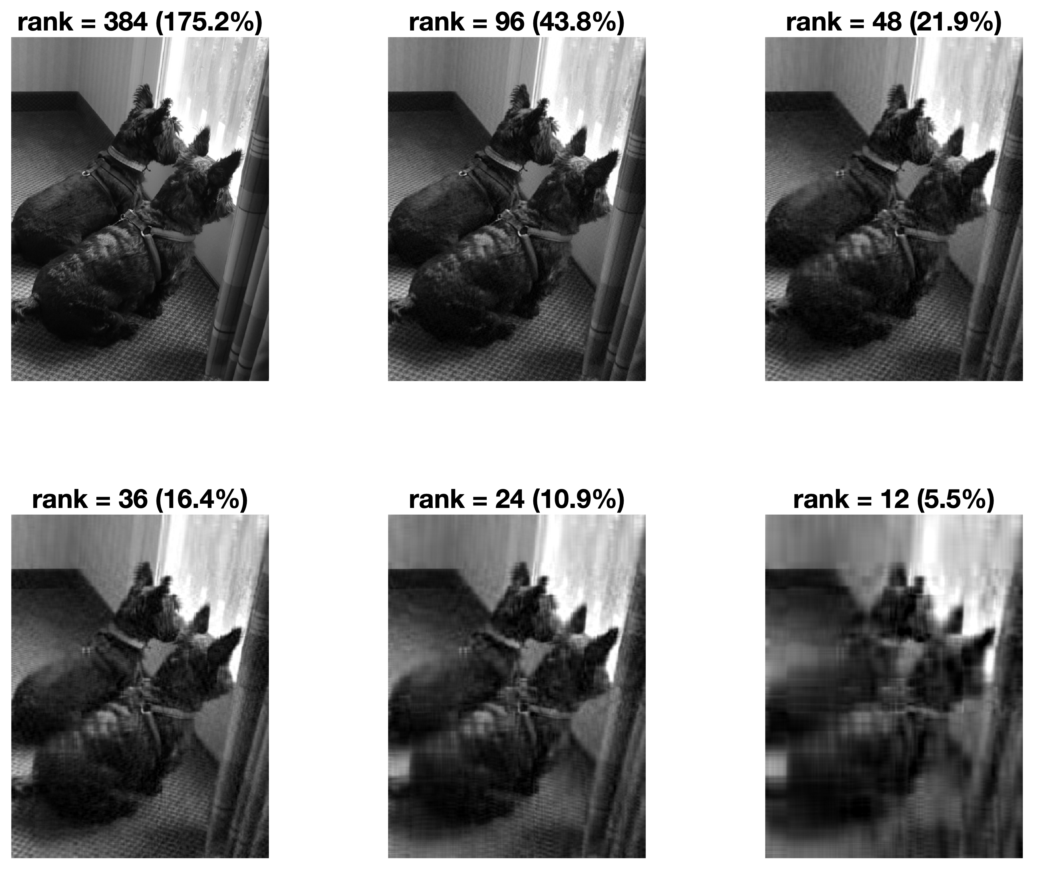

Slide 7
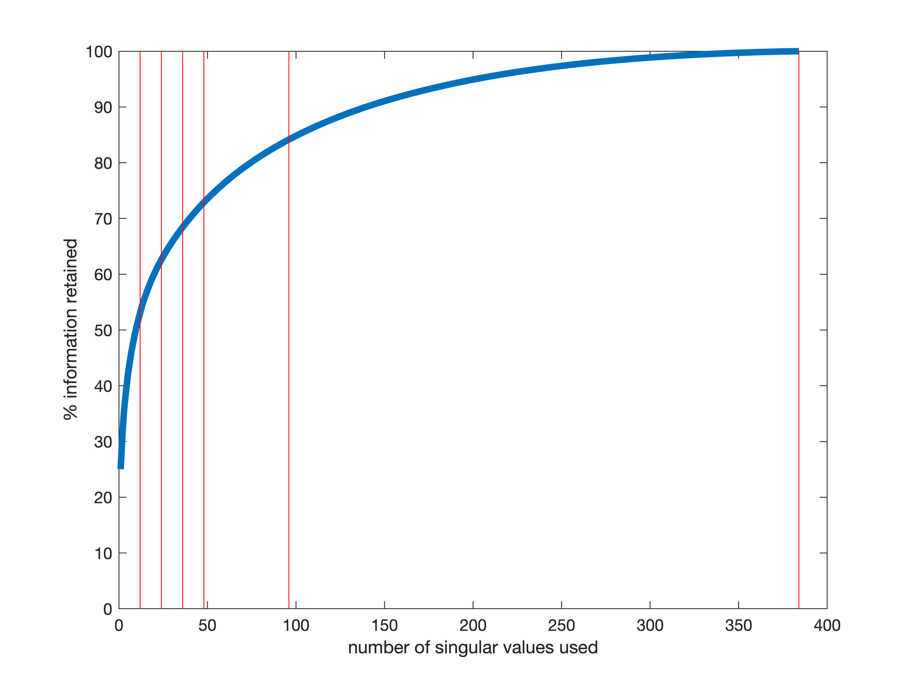

Slide 8
